Slide 1
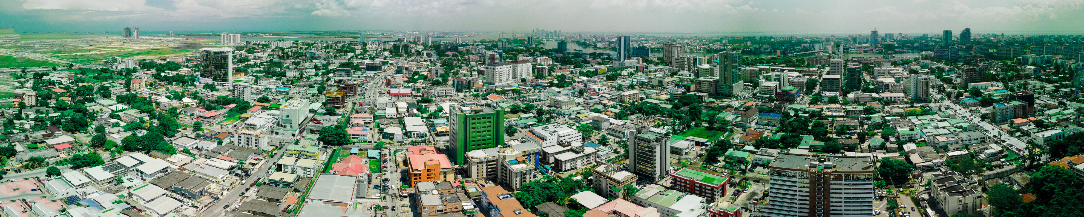
ONDO
2026 BUSINESS ENABLING REFORM ACTION PLAN (BERAP)
State Action on Business Enabling Reforms (SABER) Program

Slide 2
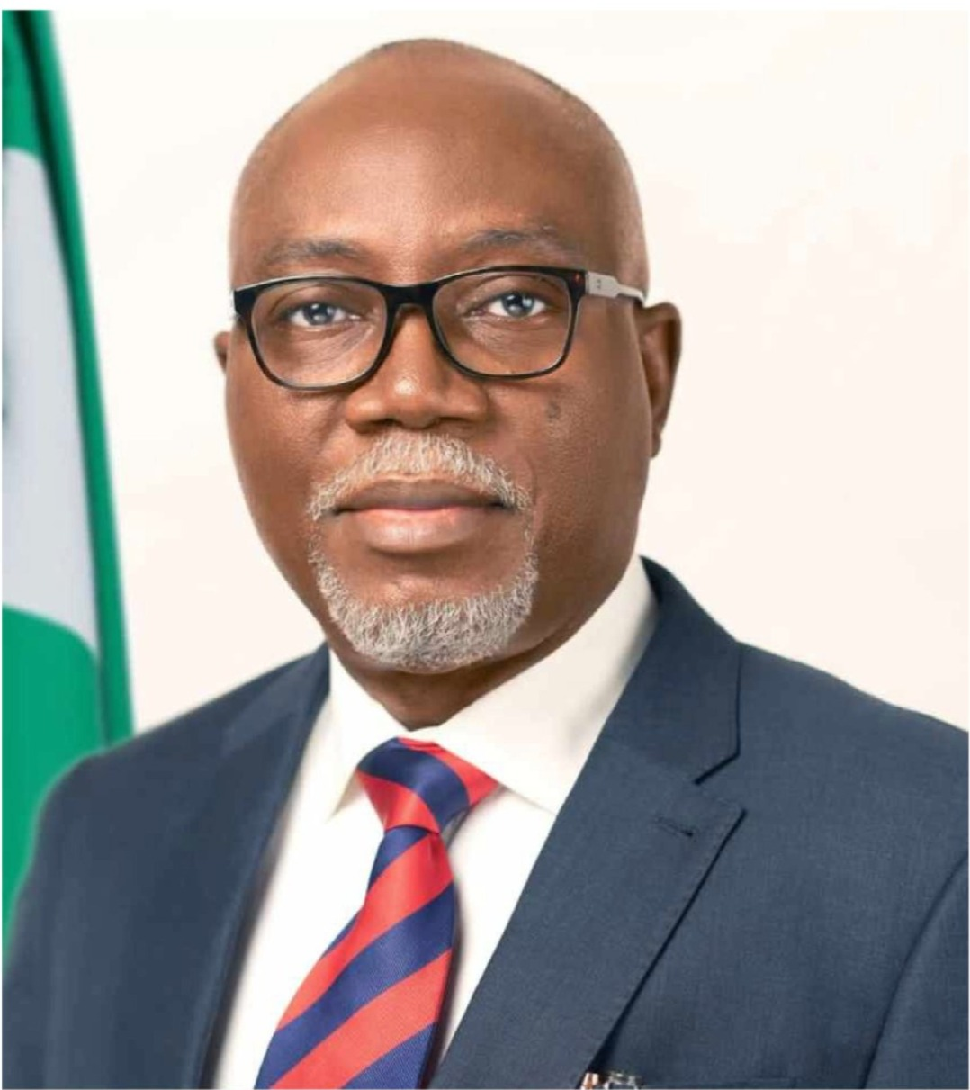
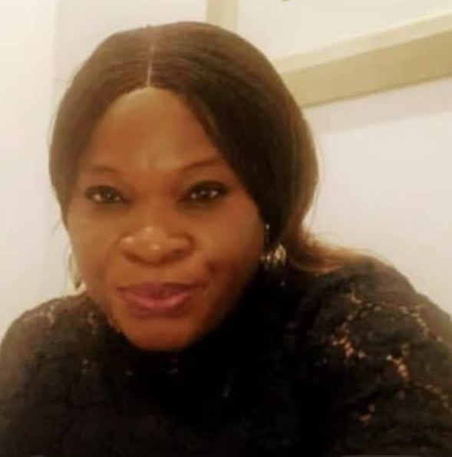
BERAP ACTION PLAN 2026
His Excellency,
Hon. Lucky Orimisan Aiyedatiwa
Executive Governor of Ondo State
Mrs Omowumi Isaac,
Hon Commissioner for Finance & Chairman EODB Ondo State
This BERAP was developed in consultation with the Private Sector in the State.

Slide 3
REFORM AREAS
ONDO STATE
Improved efficiency in property registration & sustainability of land-based investments
Development of an Effective PPP Framework
Improved regulatory framework for fiber-optic infrastructure
Improved Investment Promotion Environment
Increased Transparency of Official Fees and Procedures
Reform 1
Reform 2
Reform 3
Reform 4
Reform 5

Slide 4
ONDO STATE
Transparency of inter-state trade fees & exporter certification
Simplified State & Local Tax Regime
Quick Determination of Commercial Dispute
REFORM AREAS
Reform 8
Reform 6
Reform 7

Slide 5


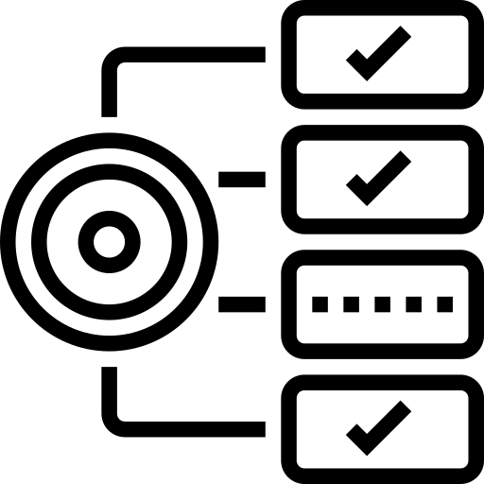

BASIS OF ASSESSMENT
ONDO STATE
BERAP ACTION PLAN
Reform 1:
Improved efficiency in property registration & sustainability of land-based investments
Reform Objective
Deliverables
Expected Impact
Achieve a faster, fully digitized, transparent, and responsible land titling system.
Complete digitization of all land titles (2016–2026) not covered in 2025 by October, 2026
Deploy a unified Land Information Management System (LIMS) in the 2nd quarter of year 2026
Introduce e-search and e-CofO verification modules.
Strengthen legal framework for digital titling and climate-responsive land use.
Conduct capacity training for surveyors and land officers in GIS and digital workflows by April, 2026
Improved investor confidence in land transactions.
Reduced corruption points and bottlenecks.
Increased revenue from more reliable land services.
Faster land access for private developers.

Slide 6

BASIS OF ASSESSMENT
ONDO STATE
BERAP ACTION PLAN
Reform 2:
Improved regulatory framework for fiber-optic infrastructure
Reform Objective
Deliverables
Expected Impact
Increase broadband penetration and ensure predictable, investor-friendly fiber deployment.
Complete 2025 fiber route mapping extension to underserved LGAs by October, 2026.
Deploy the Fiber Infrastructure Digital Registry in 1st quarter 2026.
Standardize right-of-way (RoW) processes.
Maintain and enforce the ₦145/linear-meter RoW charge.
Conduct compliance monitoring of fiber operators.
Lower cost of internet broadband.
Enhanced digital economy growth.
Attraction of ICT firms and investors.
Improved service delivery across MDAs.

Slide 7

BASIS OF ASSESSMENT
ONDO STATE
BERAP ACTION PLAN
Reform 3: Development of an effective PPP framework
Reform Objective
Expected Impact
Deliverables
Implement 2025 PPP fiscal commitment & liability framework by June 2026.
Expand PPP project pipeline from 60 to 80 projects before December 2026.
Conduct climate-risk screening for all PPP proposals by October 2026.
Launch PPP Disclosure Portal Version 2.0 by April 2026
Train MDAs on sustainable PPP procurement models by February 2026.
Host quarterly PPP investor roundtables.
Increased private sector investment inflow.
Transparent PPP environment.
Better structured, climate-resilient projects.
Improved investor confidence in Ondo.
Improve PPP project development, transparency and climate-responsiveness to attract sustainable investments.

Slide 8

BASIS OF ASSESSMENT
ONDO STATE
BERAP ACTION PLAN
Reform 4: Improved investment promotion environment
Reform Objective
Deliverables
Expected Impact
Develop & launch Ondo Investment Promotion Strategy 2026–2030 by May, 2026.
Establish Investor Facilitation Desk (IFD) at ONDIPA.
Conduct security-investment summit (annual) by August 2026.
Implement investor aftercare program for business retention.
Streamline investment incentive administration.
Publish annual “Invest in Ondo Report.”
Increased FDI & local investments.
Increase business retention rates by 30% by the end of year 2026.
Improved global investment and industrial perception of Ondo State.
Stronger private sector collaboration.
Create a competitive, investor-friendly environment through targeted marketing, security assurance and simplified entry procedures.

Slide 9

BASIS OF ASSESSMENT
ONDO STATE
BERAP ACTION PLAN
Reform 5: Increased transparency of official fees & procedures
Reform Objective
Deliverables
Expected Impact
Review all state fees for transparency and proper gazetee by March 2026.
Publish fees across all key business-enabling MDAs by February, 2026.
Digitize and centralize fee disclosure on government portal February 2026.
Create grievance mechanism desk in 5 additional MDAs (i.e from present 5 to 10 MDAs).
Conduct public awareness campaigns on fees and service timelines by March 2026.
Integrate fee-related grievance tracking with ODIRS dashboard by May 2026.
To make all fees, process timelines and procedures of the business enabling environment MDAs fully transparent, predictable, accessible and automated.
(ii). To create a one stop for
Information sharing, Grievances Redress Mechanism for the business enabling environment MDAs.
Increased revenue transparency.
Reduced extortion and illegal fees.
Improved taxpayer compliance.
Higher state revenue performance.

Slide 10
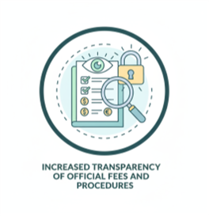
BASIS OF ASSESSMENT
ONDO STATE
BERAP ACTION PLAN
Reform 6: Transparency of inter-state trade fees & exporter certification
Expected Impact
Reform Objective
Deliverables
Deploy inter-state trade portal with real-time fee information.
Establish mobile enforcement teams to eliminate illegal border levies and monitor the removal of haulage fee by January, 2026.
Expand exporters’ certification support program.
Publish list of authorized checkpoints by March 2026.
Train transport unions on legal fees/tariffs.
Facilitate export documentation clinics.
Reduced cost of moving goods.
Boost inter state trade competitiveness.
Increased access to export markets.
Expansion of non-oil revenue.
To regulate and Promote corruption-free inter-state trade and strengthen export readiness.

Slide 11

BASIS OF ASSESSMENT
ONDO STATE
BERAP ACTION PLAN
Reform Objective
Deliverables
Expected Impact
Reform 7: Simplified State & Local Tax Regime
Finalize consolidated tax code draft initiated in 2025.
Implement presumptive turnover tax for MSMEs.
Digitize local government business taxes.
Expand single demand notice to all LGAs.
Train LG revenue officers on unified tax administration by June 2026.
Conduct taxpayer education programs statewide by March 2026.
Reduced compliance burden on MSMEs.
Higher voluntary compliance.
Fair, harmonized tax system.
Increased state IGR.
Simplify tax compliance, harmonize rates, and improve MSME tax transparency.

Slide 12

BASIS OF ASSESSMENT
ONDO STATE
BERAP ACTION PLAN
Reform Objective
Deliverables
Expected Impact
Reform 8:
Quick Determination of Commercial Dispute
Conduct training for Magistrates and Registrars for the scheme by 2nd quarter of 2026
Conduct awareness campaign to sensitize the public on the existence of the Small Claim Court by February, 2026.
Employment of more Adjudicators such as Magistrates by July 2026.
1. To maintain speedy and accelerated hearing.
2. Reduce adjudication time in commercial dispute.
To establish a
Special Court
(e.g. Small
Claims Court)
For Commercial
dispute of Micro and
Small Enterprises.

